Slide 1

NASDAQ: NVDA
March 2024
TMT Team
This presentation is for informational purposes only and is not an offer to buy or sell or a solicitation to buy or sell any securities, investment products or other financial product or service, or an official confirmation of any transaction.

Slide 2
Table of Contents
1
Context
1
Trend
2
Chart Analysis
Canals
Support/Resistance
Candle sticks
3
Technical inidcators

Slide 3
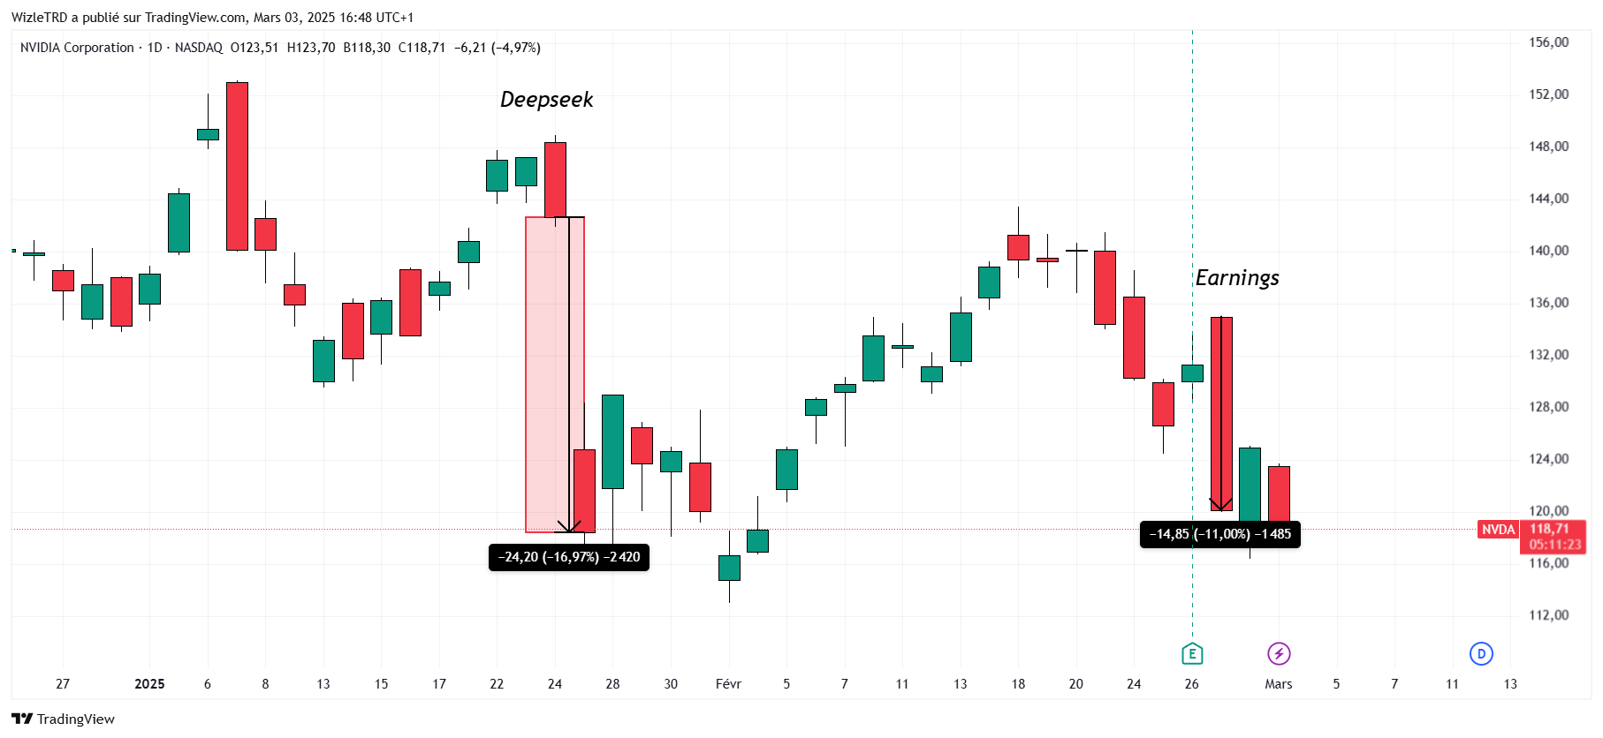
Context
Impact of DeepSeek: On January 27, 2025, Chinese startup DeepSeek announced the launch of its AI model, DeepSeek R1, which is both powerful and cost-effective. This announcement triggered a 17% drop in NVIDIA's stock, wiping out nearly $600 billion in market capitalization, marking the largest single-day loss for a publicly traded company in U.S. history. (Source: Reuters)
Q1 2025 Earnings Report: On February 26, 2025, NVIDIA reported its Q4 fiscal year 2025 earnings, posting record revenue of $39.3 billion, a 78% year-over-year increase. However, despite strong financial results, NVIDIA's stock fell by 8.5% due to concerns about rising spending in the tech sector and lower profit margins projected for Q1 2025. (Source: Reuters)

Slide 4
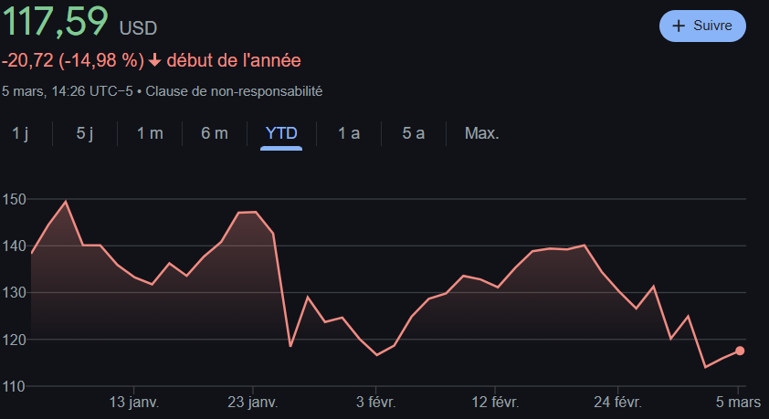
Context

Slide 5
Market Inefficiency and the Generalized Overvaluation of Financial Assets
1. The Efficient Market Hypothesis: Foundations and Assumptions
The Efficient Market Hypothesis (EMH), formulated by Eugene Fama in 1970, asserts that financial asset prices always incorporate all available information. This theory relies on several fundamental assumptions:
Investor Rationality: All market participants are rational and make decisions based on economic fundamentals.
Perfect Arbitrage: Even if some investors act irrationally, arbitrage by other market participants quickly corrects any mispricing.
Instant Information Diffusion: Any new information is immediately reflected in asset prices, making it impossible to consistently beat the market without taking on additional risk.
EMH exists in three forms:
Weak-form efficiency: Current prices incorporate all past information, rendering technical analysis ineffective.
Semi-strong efficiency: All publicly available information is already reflected in prices, making fundamental analysis futile.
Strong-form efficiency: Even private and confidential information is already priced in, meaning no investor can gain an advantage, even with insider knowledge.
2. Generalized Market Overvaluation: Evidence of Inefficiency
Today, overvaluation is not limited to the technology sector—the entire U.S. financial market exhibits excessive valuation levels.
High Price-to-Earnings (P/E) Ratio: The average P/E ratio of the S&P 500 is significantly above historical averages, a trend seen across multiple sectors, including finance, industry, and consumer goods.
Market Capitalization-to-GDP Ratio ("Buffett Indicator") at record levels, suggesting that the market is detached from real economic growth.
Elevated Valuation Multiples: The Price-to-Book (P/B), EV/EBITDA, and Q Ratio indicate that assets are trading well above their intrinsic value.
Speculative Effect and Excess Liquidity: Accommodative monetary policies in recent years have fueled excessive risk-taking, pushing valuations to historically high levels.
This widespread overvaluation demonstrates that asset prices are no longer solely dictated by economic fundamentals but also by irrational behaviors, massive capital flows, and crowd effects.

Slide 6
Market Inefficiency and the Generalized Overvaluation of Financial Assets
3. Academic Evidence of Market Inefficiency
Several empirical studies challenge Fama’s theory and show that the market is not fully efficient:
Robert Shiller (1981) and Irrational Exuberance: He demonstrated that stock prices are far more volatile than underlying economic fundamentals justify. This observation invalidates EMH by highlighting the presence of speculative bubbles.
Momentum Effect (Jegadeesh & Titman, 1993): These researchers proved that stocks that have performed well over the past 3 to 12 months tend to continue outperforming, which contradicts weak-form efficiency.
Value vs. Growth Anomaly (Fama & French, 1992): They found that undervalued stocks (low P/E, low P/B) outperform in the long run, contradicting semi-strong efficiency.
Market Crashes and Speculative Bubbles: Events like the 2000 Dot-Com Bubble, the 2008 Subprime Crisis, and the 2021 Crypto Bubble demonstrate that markets do not always reflect the intrinsic value of assets.
All these findings suggest that markets are not purely rational and that behavioral biases play a key role in price evolution.
4. Why Technical Analysis Becomes an Essential Tool
In a market where prices are influenced by investor irrationality, speculation, and crowd effects, fundamental analysis loses effectiveness. This is where technical analysis becomes relevant.
Definition and Principles of Technical Analysis
Technical analysis relies on studying past price movements to identify future trends. It is based on three principles:
The Market Prices in Everything: Charts reflect all relevant information (investor psychology, capital flows, liquidity).
Prices Follow Trends: Financial assets tend to move in upward and downward cycles, often dictated by collective behaviors.
History Repeats Itself: Investor reactions to events are cyclical, allowing for the identification of chart patterns and recurring formations.

Slide 7
Market Inefficiency and the Generalized Overvaluation of Financial Assets
4.2. Connection to Behavioral Finance
Technical analysis indirectly relies on behavioral finance, which studies investors’ cognitive biases. Some irrational behaviors explain why markets deviate from fundamentals:
Confirmation Bias: Investors tend to seek information that confirms their beliefs, fueling speculative bubbles.
Herd Mentality: Many traders follow the general trend, amplifying market rallies and downturns.
Loss Aversion: Investors react more strongly to losses than to gains, leading to panic selling during bad news.
Thus, technical analysis helps anticipate these irrational reactions by identifying key support and resistance levels and reversal signals.
5. Conclusion: Shifting to Technical Analysis
The extreme valuations of U.S. financial markets indicate that the market is largely inefficient. Prices are not solely driven by fundamentals but also by investor psychology, liquidity flows, and speculation.
Given this inefficiency, we will use technical analysis to identify trends and opportunities. In the next section, we will examine key technical indicators to anticipate future price movements.
Disclaimer: In retail trading, the expected return remains negative. The failure of individual investors in the stock market is not due to a lack of knowledge but to psychology: overconfidence, fear of losses, and impulsivity destroy performance. Unlike day trading and scalping, where high fees and competition with algorithms reduce the expected return, swing trading allows traders to capture broader trends with less stress and fewer impulsive decisions. A disciplined approach tailored to market structure is essential to maximize profitability.
https://docs.google.com/document/d/1kj7HYihOFkGvgQ79fM7Xx3dEpchFOLfbVRDIADn_QMo/edit?usp=sharing

Slide 8
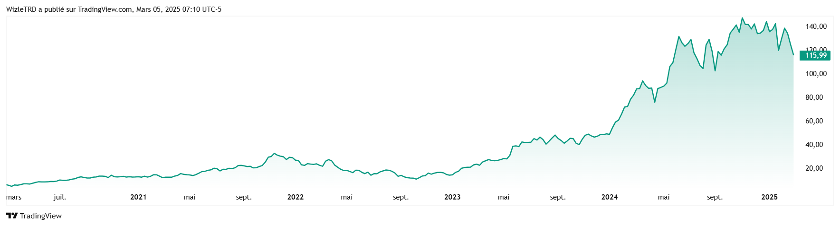
Trend
From $14.86 in 03/01/2023 to $147.63 04/11/2024
(+893,47%) (x9.93)

Slide 9
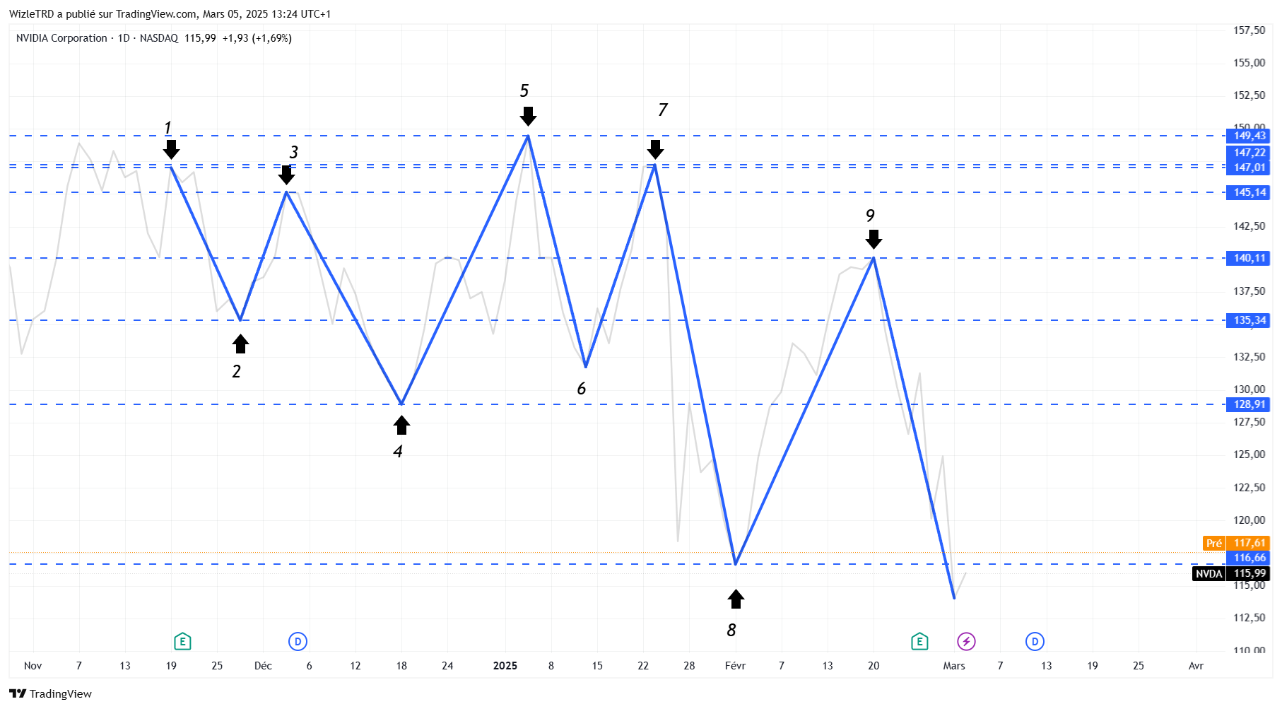
Trend

Slide 10
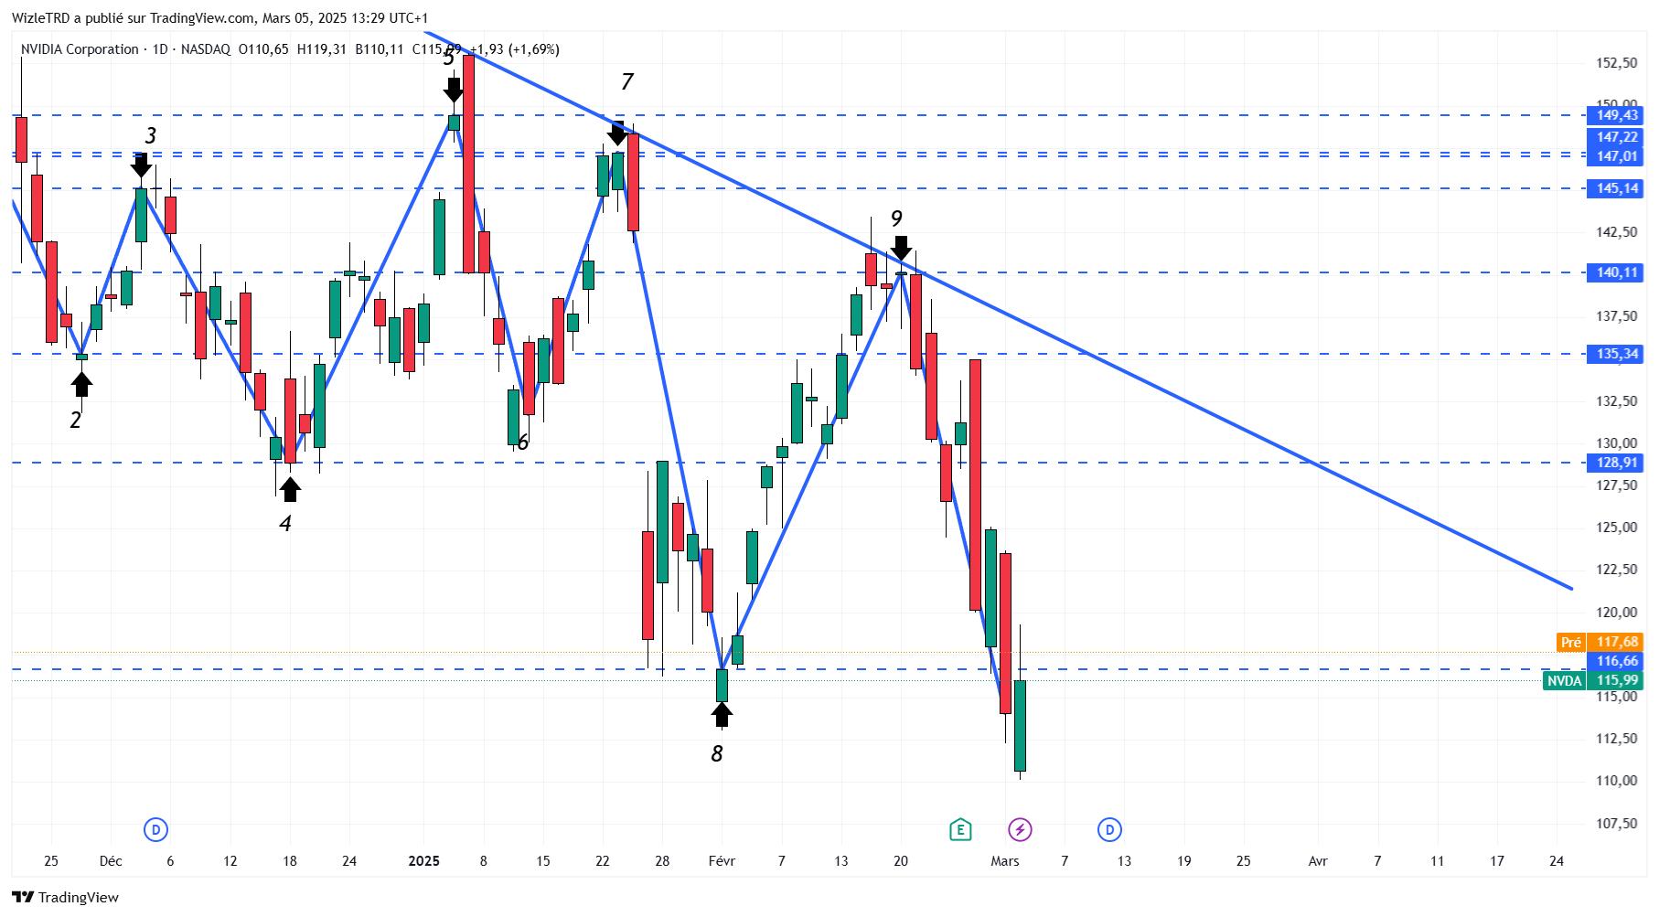
Trend

Slide 11
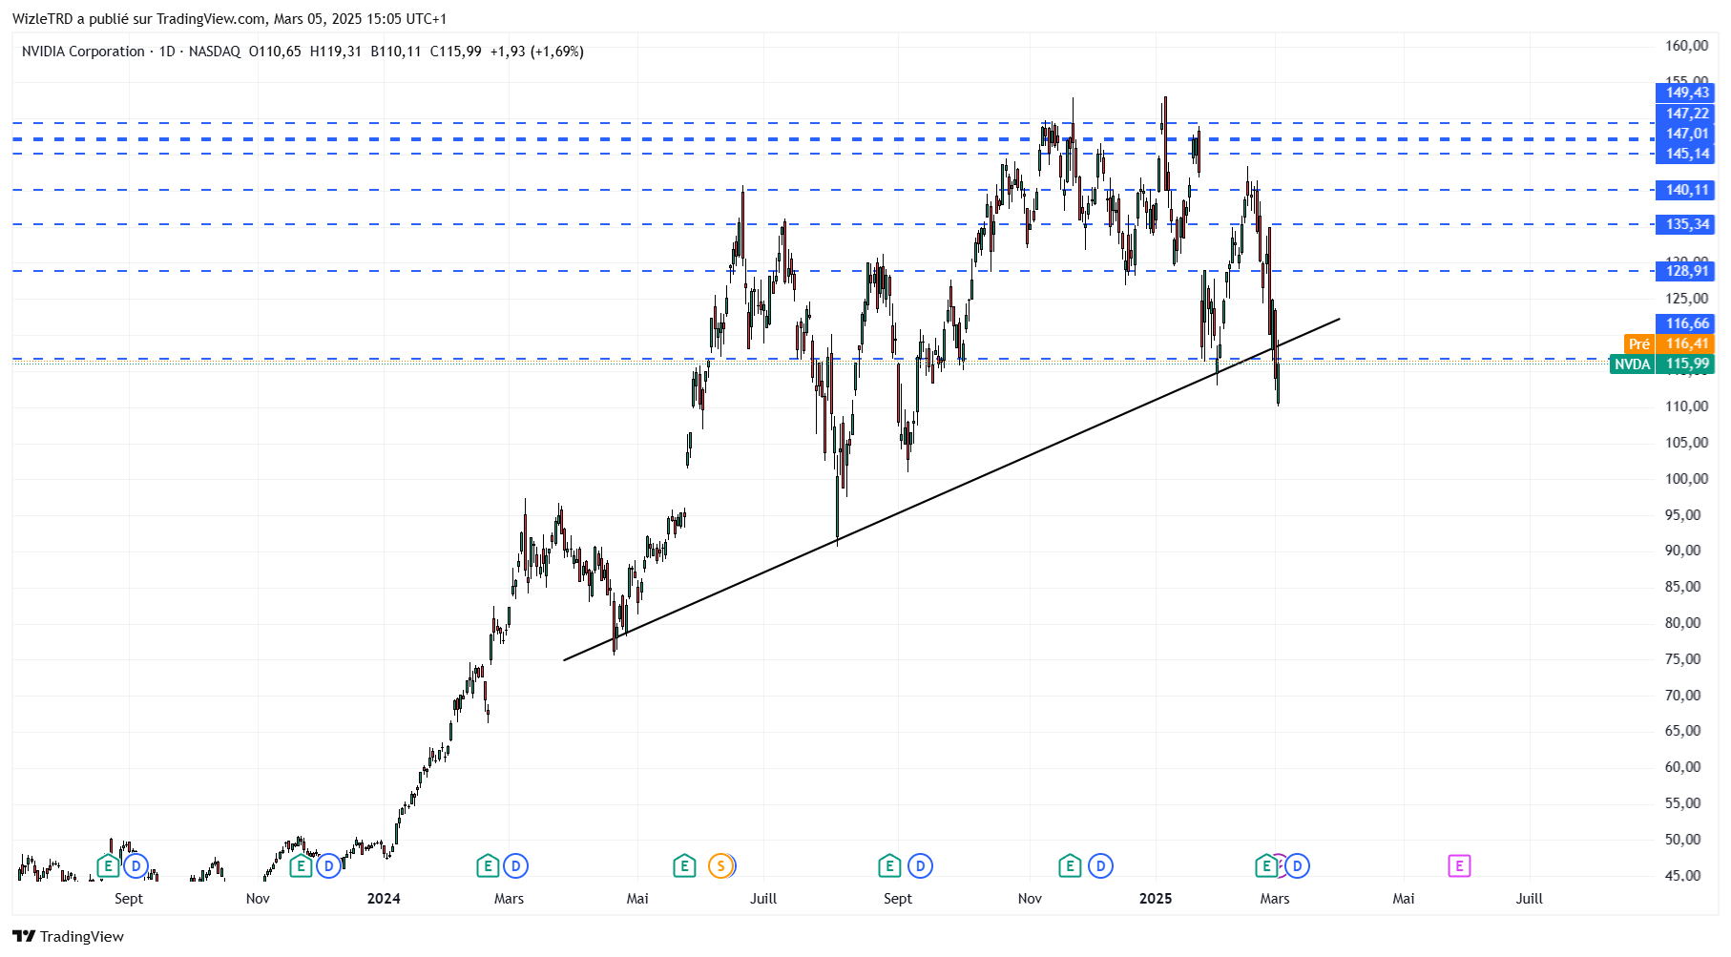
Trend

Slide 12
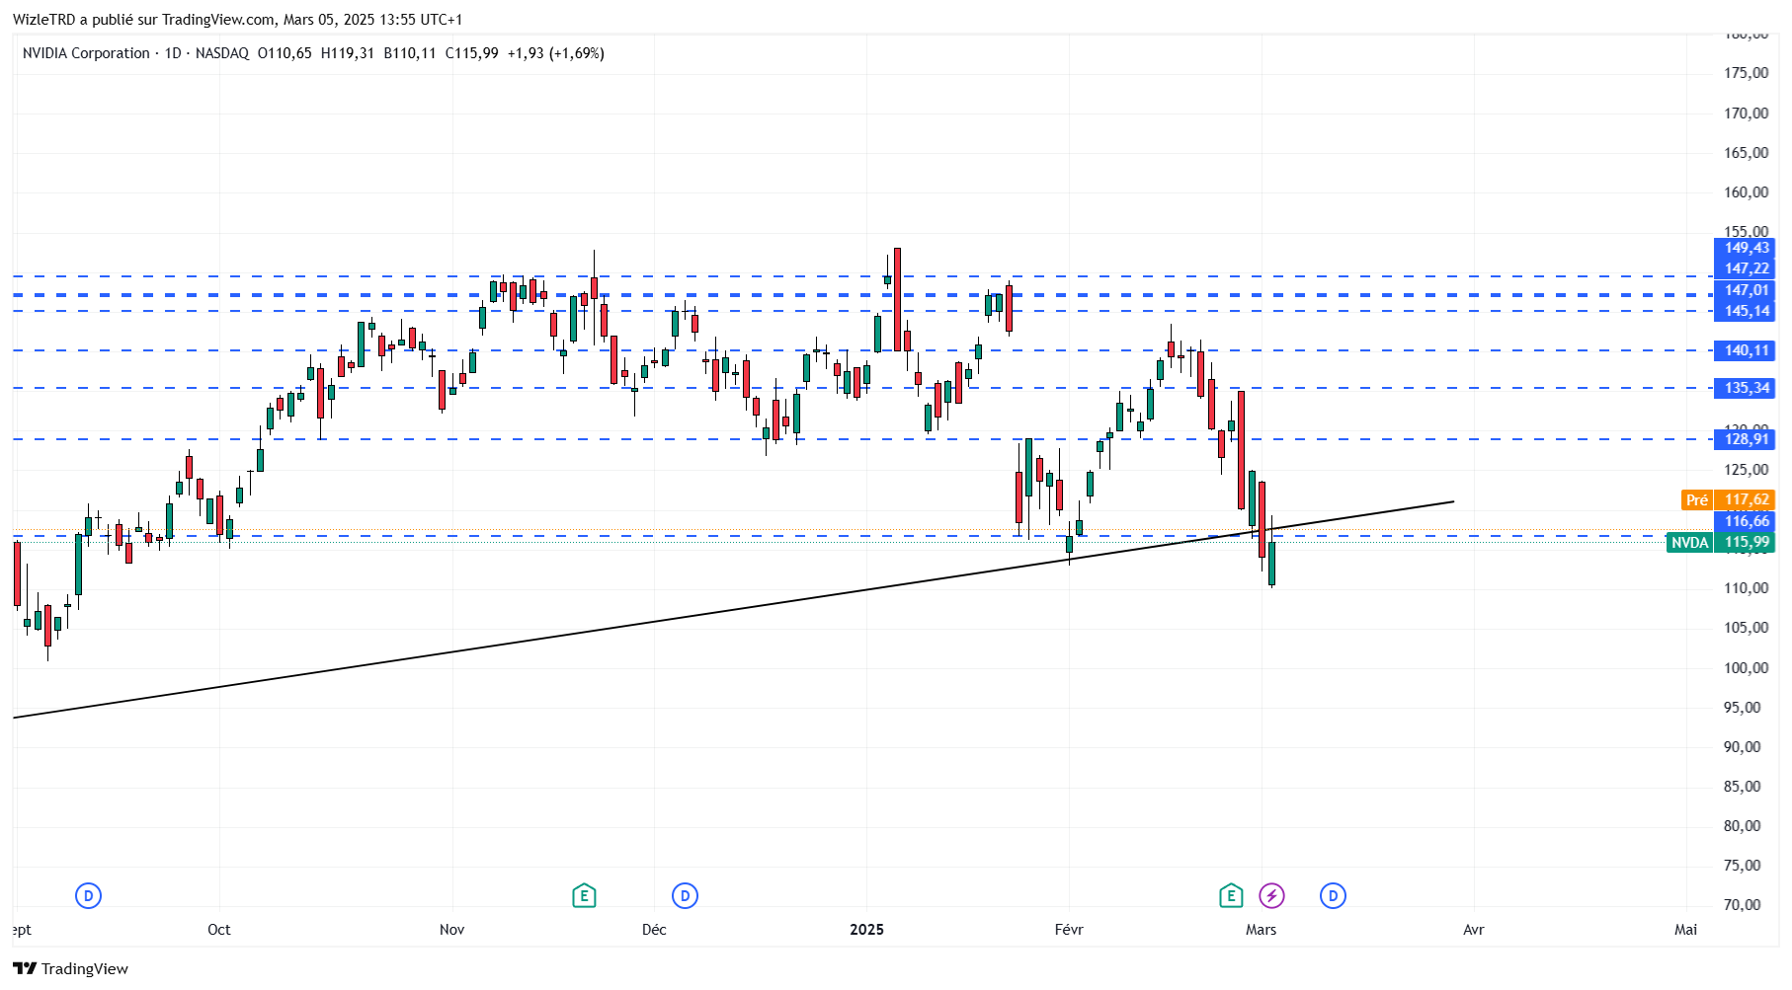
Trend

Slide 13
Trend explanation
A downtrend (or bearish trend) is a market phase characterized by a gradual decline in prices. It is defined by a series of lower highs (LH) and lower lows (LL).
Explanation with Lower Highs and Lower Lows:
Lower High (LH)
Each new high is lower than the previous high. This indicates that buyers are losing strength and sellers are gaining control.
Lower Low (LL)
Each new low is lower than the previous low. This confirms that selling pressure is dominant and the market continues to decline. An uptrend (or bullish trend) is a market phase characterized by a gradual increase in prices. It is defined by a series of higher highs (HH) and higher lows (HL).
Explanation with Higher Highs and Higher Lows:
Higher High (HH)
Each new high is higher than the previous high. This indicates that buyers are in control and pushing prices upward.
Higher Low (HL)
Each new low is higher than the previous low. This confirms that buying pressure is dominant and the market continues to rise.

Slide 14
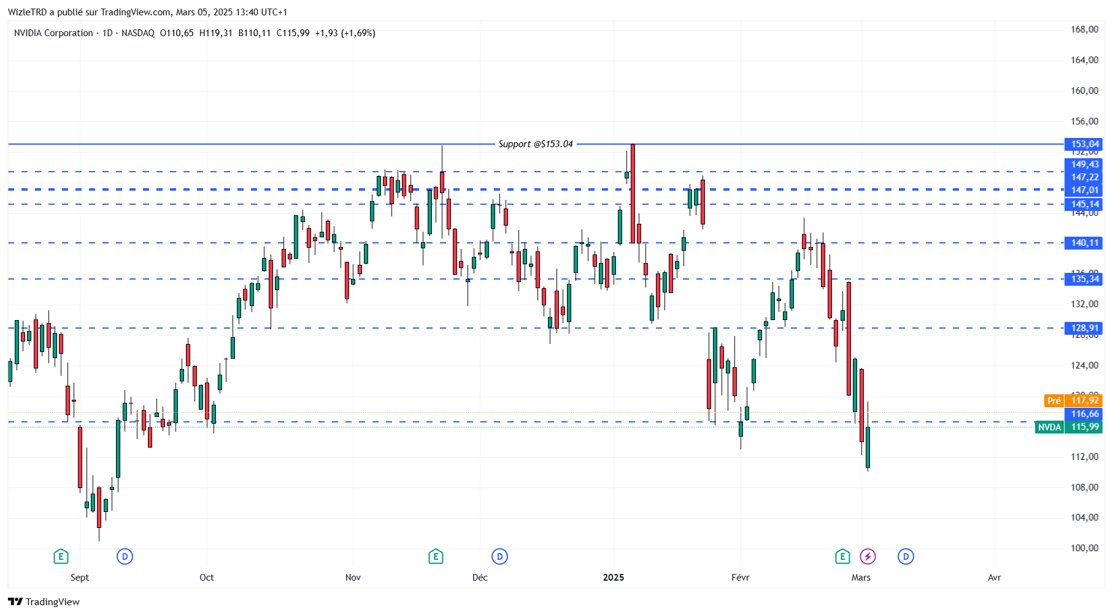
Support

Slide 15
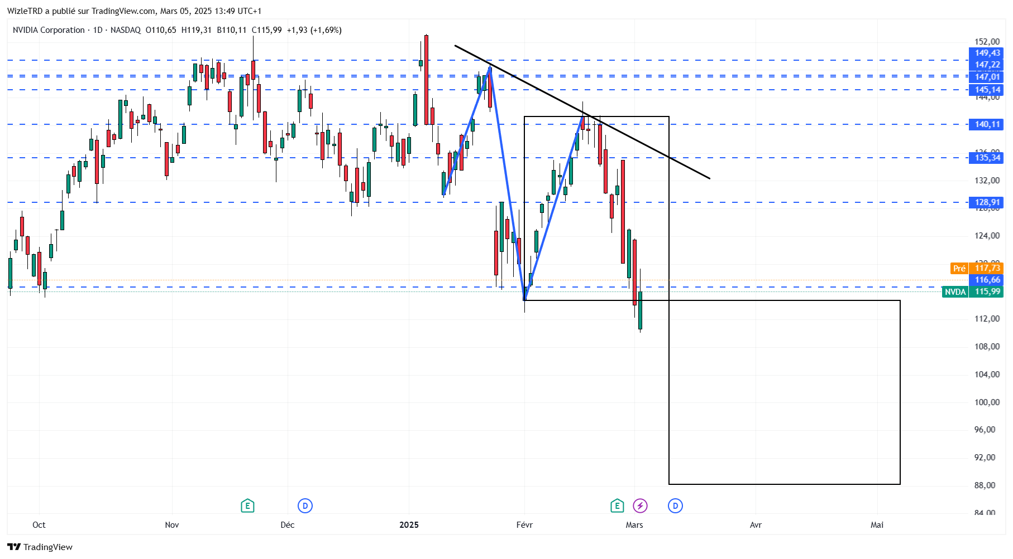
Pattern

Slide 16
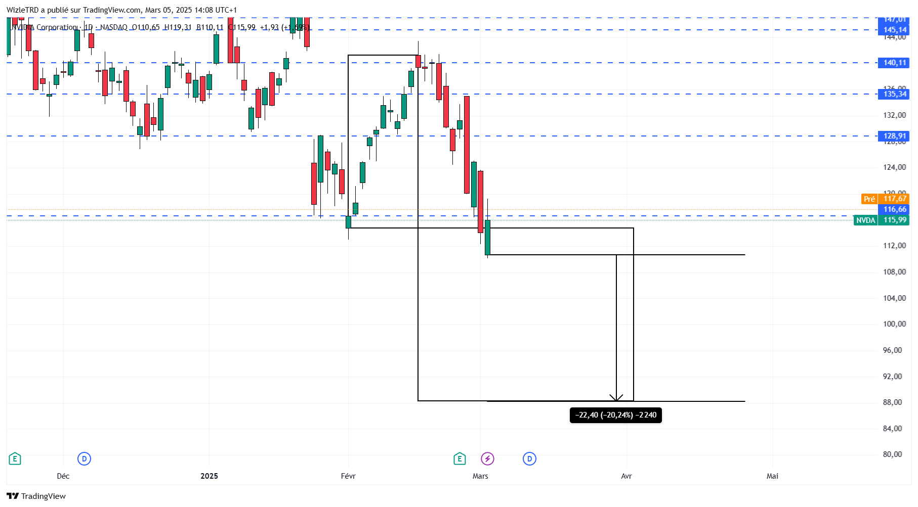
Pattern

Slide 17
Pattern explanation
Why Does Pattern Recognition Work in Trading?
Pattern recognition in trading works because financial markets are influenced by repetitive human behaviors. These behaviors create recurring patterns on price charts, which can be leveraged to anticipate future movements. Here’s why this approach is effective:
1. Crowd Psychology and Repetitive Behavior
Traders and investors often react similarly to market events (fear, euphoria, uncertainty). These reactions create recognizable formations, such as continuation patterns (flags, triangles) or reversal patterns (head and shoulders, double top).
2. Self-Fulfilling Effect
Many traders and algorithms use technical analysis and look for the same patterns. When a pattern is identified, orders are placed based on its predictions, reinforcing its validity (e.g., a support breakdown triggering massive selling).
3. Based on Probabilities, Not Certainties
Pattern recognition does not predict the future with certainty, but it identifies configurations with high probability of success based on historical price behavior. Combining these patterns with other technical indicators (volume, RSI, MACD, etc.) improves forecast reliability.
4. Alignment with Dow Theory
Dow Theory states that markets move in trends and that history repeats itself. Pattern recognition relies on these principles by identifying structures that indicate trend reversals or continuations.
Limitations of Pattern Recognition
False Signals: A pattern may seem valid but fail (false flag breakout, fake breakout).
Market Context: The same pattern can behave differently depending on volatility, economic news, or volume.
Need for Confirmation: Traders often combine pattern recognition with other indicators to avoid acting on isolated signals.
Conclusion: Pattern recognition works because it leverages market psychology and repetitive trends. It does not guarantee 100% success, but when used correctly, it provides a statistical edge in trading decisions.

Slide 18
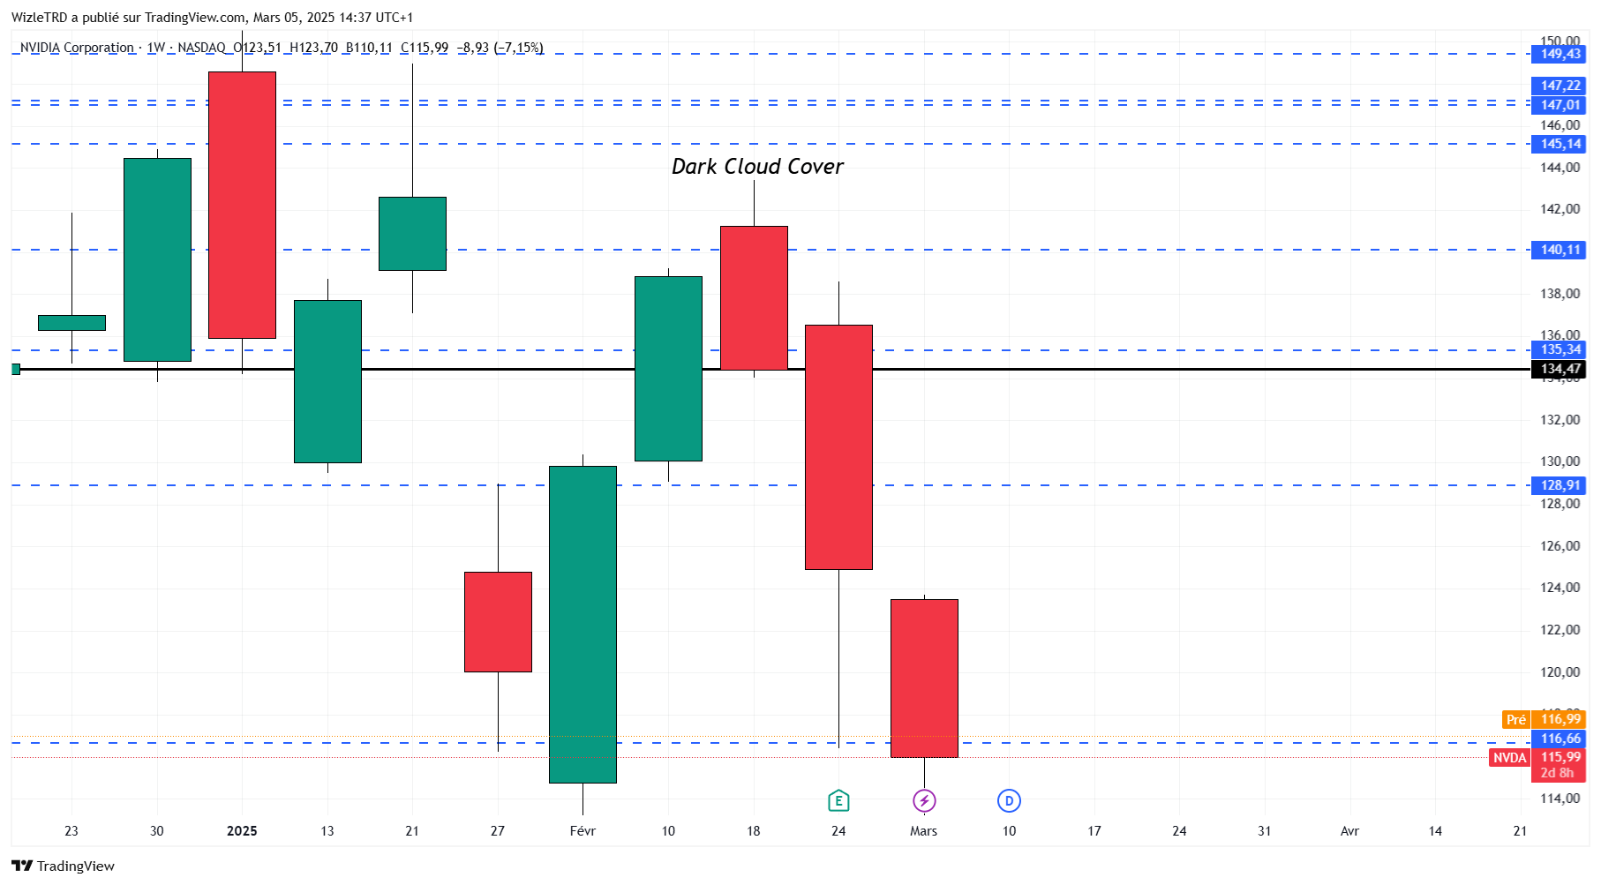
Candle Sticks W

Slide 19
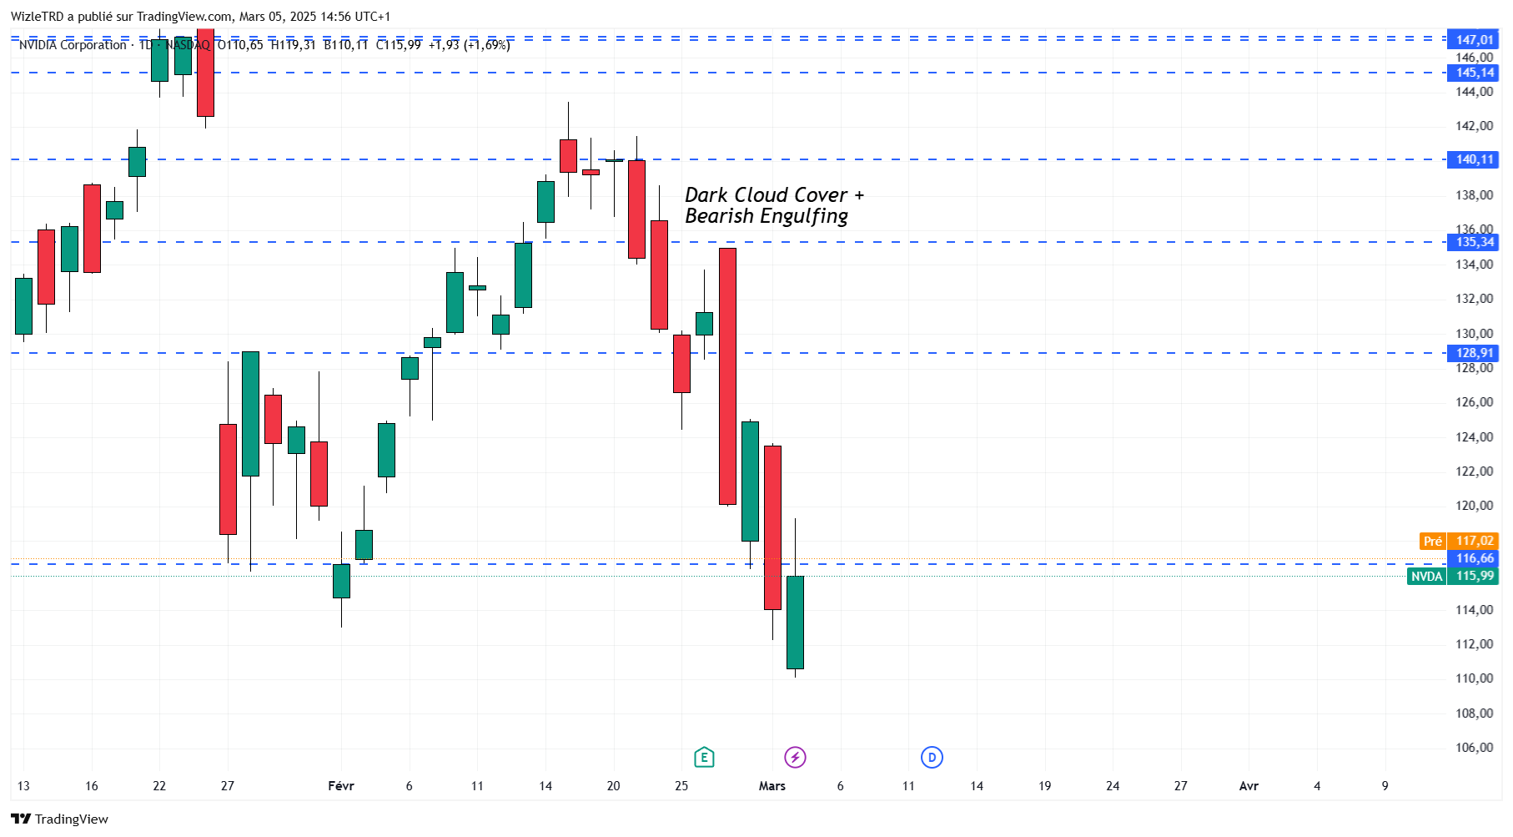
Candle Sticks D
The market psychology behind these formations is identical: during a bullish market, investors tend to become euphoric, leading many to buy near the peaks. Those who entered at the highest levels are particularly vulnerable, and at market extremes, even a slight reversal can trigger a wave of panic selling.

Slide 20
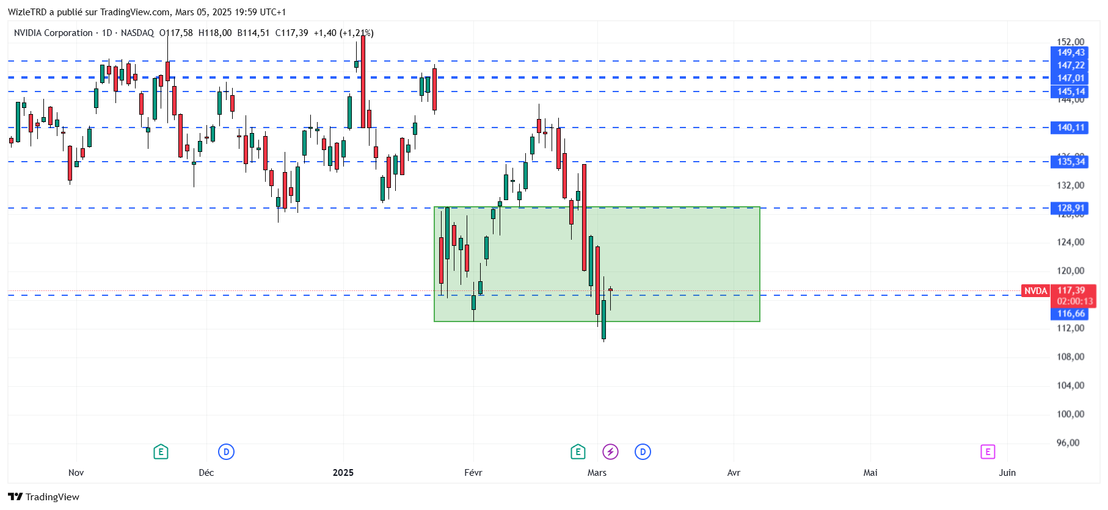
Candle Sticks D

Slide 21
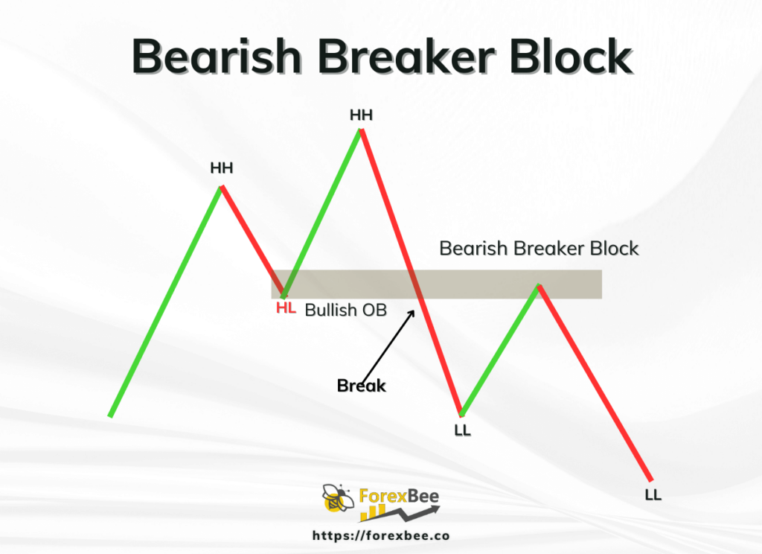
Candle Sticks D

Slide 22
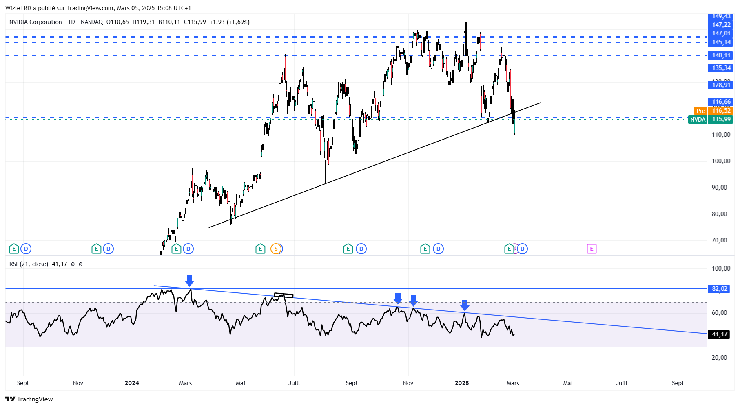
Indicators

Slide 23
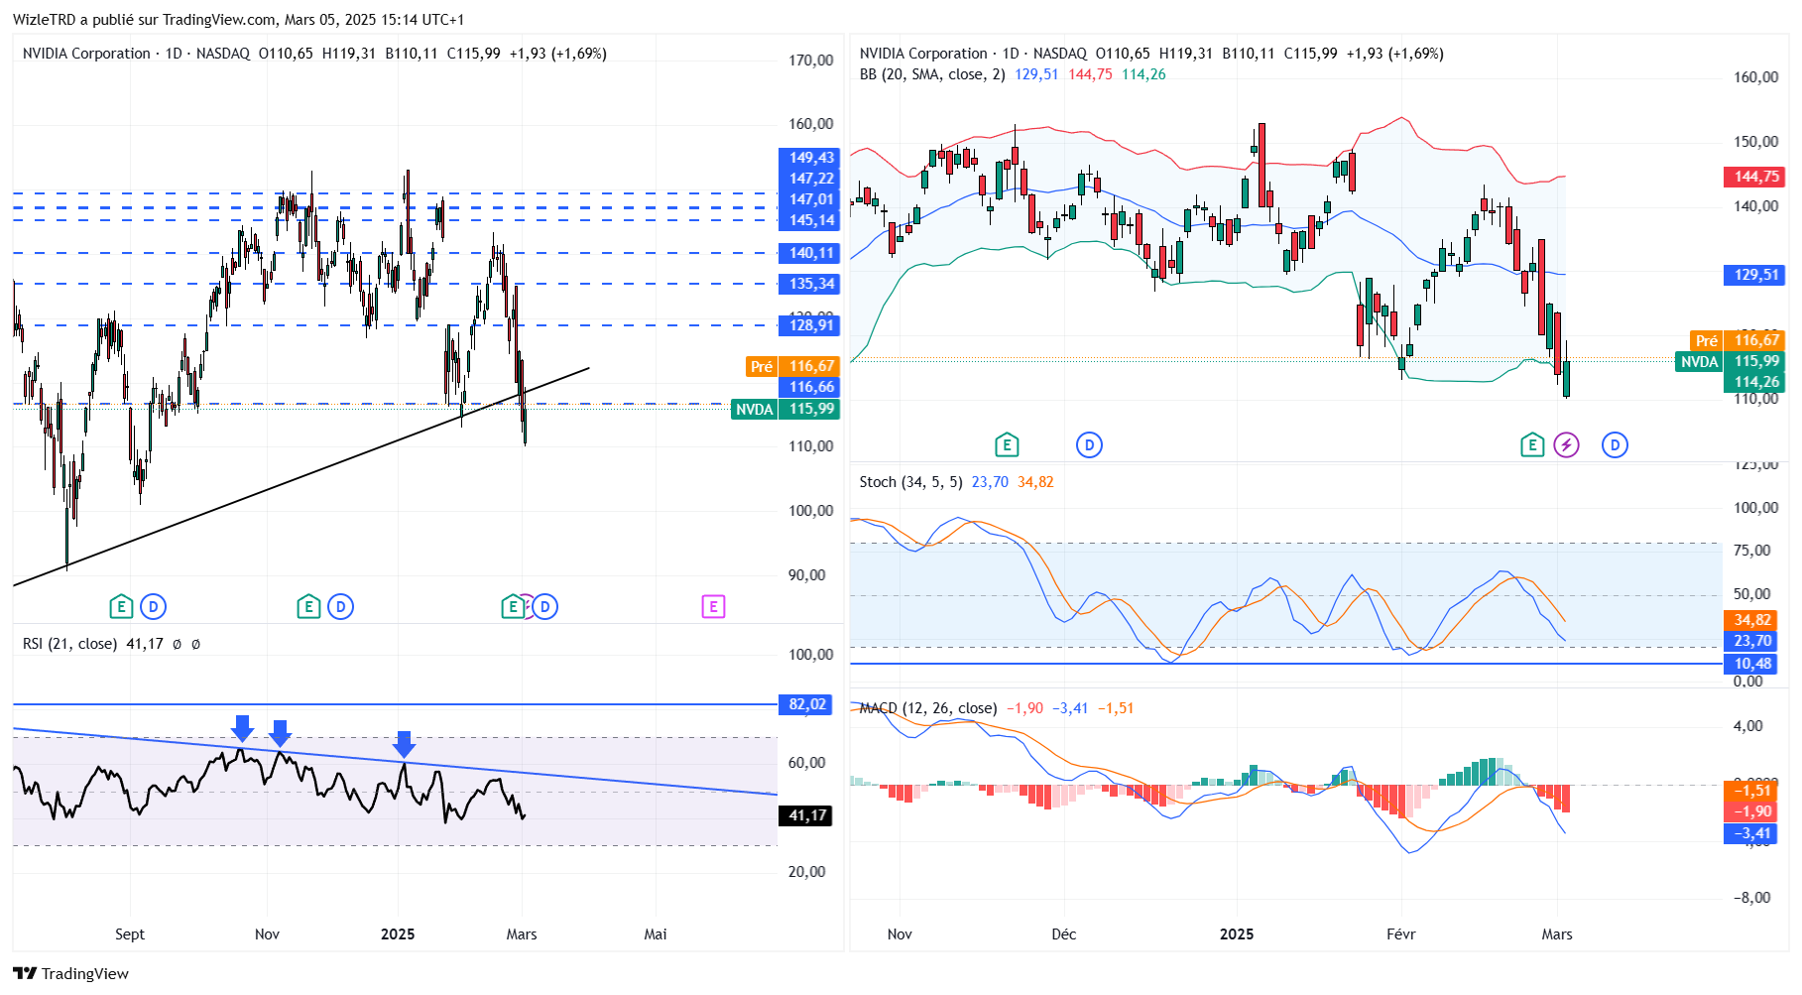
Indicators

Slide 24
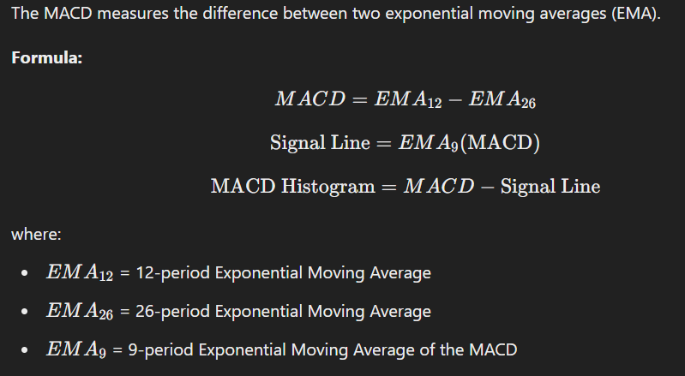
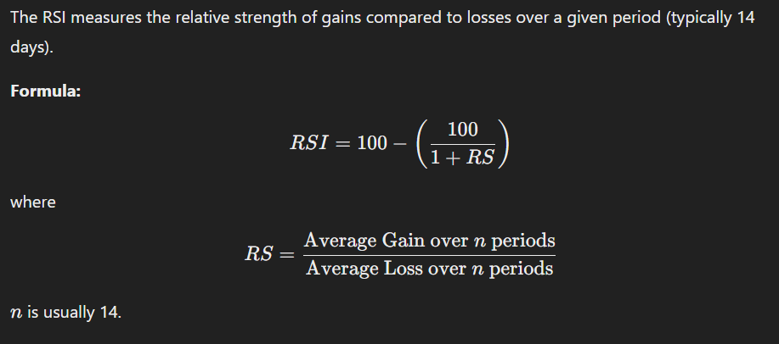
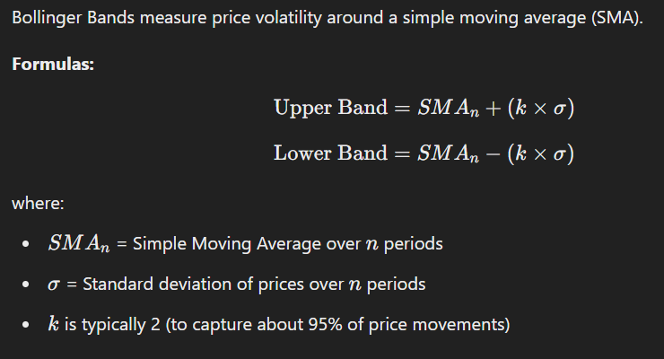
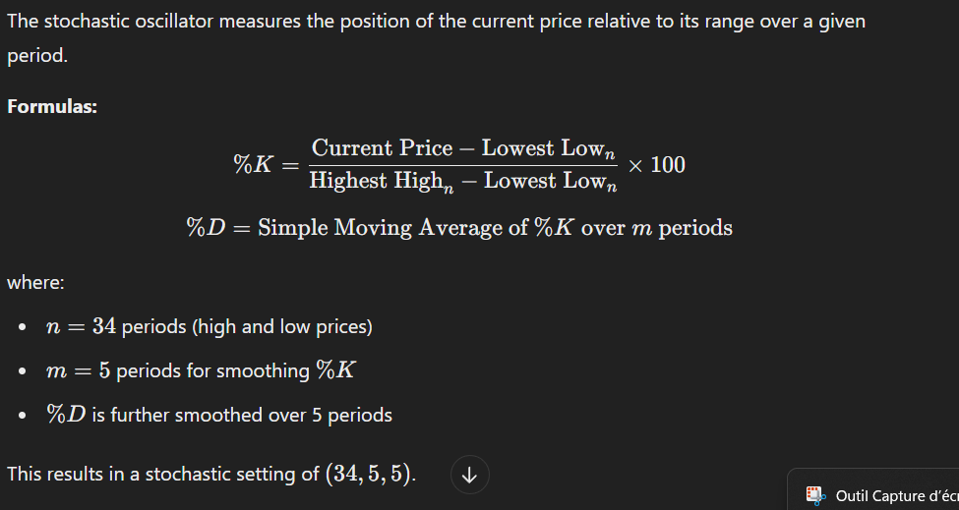
Indicators

